Slide 1
Network Fundamentals for Cloud
Nishit Narang
WILPD-CSIS

Slide 2
CC ZG503: Network Fundamentals for Cloud
Lecture No. 4

Slide 3

RECAP: Services, Layering and Encapsulation
application
transport
network
link
physical
M
application
transport
network
link
physical
M
message
H_{t}
M
H_{t}
M
segment
H_{n}
H_{t}
M
H_{n}
H_{t}
M
datagram
H_{l}
H_{n}
H_{t}
M
H_{l}
H_{n}
H_{t}
M
frame
source
destination

Slide 4
[RECAP] Encapsulation: an end-end view
source
message
M
application
transport
network
link
physical
segment
H_{t}
M
H_{t}
datagram
H_{n}
H_{n}
H_{t}
M
frame
H_{l}
H_{n}
H_{t}
M
link
physical
switch
destination
H_{n}
H_{t}
M
network
link
physical
M
application
transport
network
link
physical
H_{l}
H_{n}
H_{t}
M
H_{n}
H_{t}
M
H_{t}
M
H_{n}
H_{t}
M
H_{l}
H_{n}
H_{t}
M
router

Slide 5
ISO/OSI reference model
Two layers not found in Internet protocol stack!
presentation: allow applications to interpret meaning of data, e.g., encryption, compression, machine-specific conventions
session: synchronization, checkpointing, recovery of data exchange
Internet stack “missing” these layers!
these services, if needed, must be implemented in application
needed?
application
presentation
session
transport
network
link
physical
The seven layer OSI/ISO
reference model

Slide 6


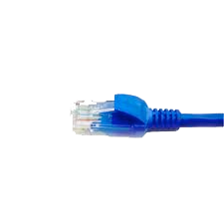
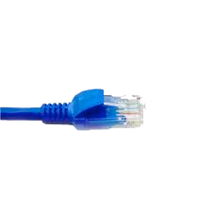
Wireshark
application
(www browser,
email client)
packet
analyzer
application
OS
packet
capture
(pcap)
Transport (TCP/UDP)
Network (IP)
Link (Ethernet)
Physical
copy of all Ethernet frames sent/received

Slide 7
Fundamentals of Networking:
Network Layer Routing
Slides Source: Computer Networking: A Top-Down Approach, 8th edition, Jim Kurose, Keith Ross, Pearson, 2020
All material copyright 1996-2020
J.F Kurose and K.W. Ross, All Rights Reserved

Slide 8

Network layer: Topics to be covered
Introduction to control and data plane
routing protocols
link state
distance vector
intra-ISP routing: OSPF
routing among ISPs: BGP

Slide 9
Network-layer functions
forwarding: move packets from router’s input to appropriate router output
data plane
routing: determine route taken by packets from source to destination
control plane
Two approaches to structuring network control plane:
per-router control (traditional)
logically centralized control (software defined networking)

Slide 10

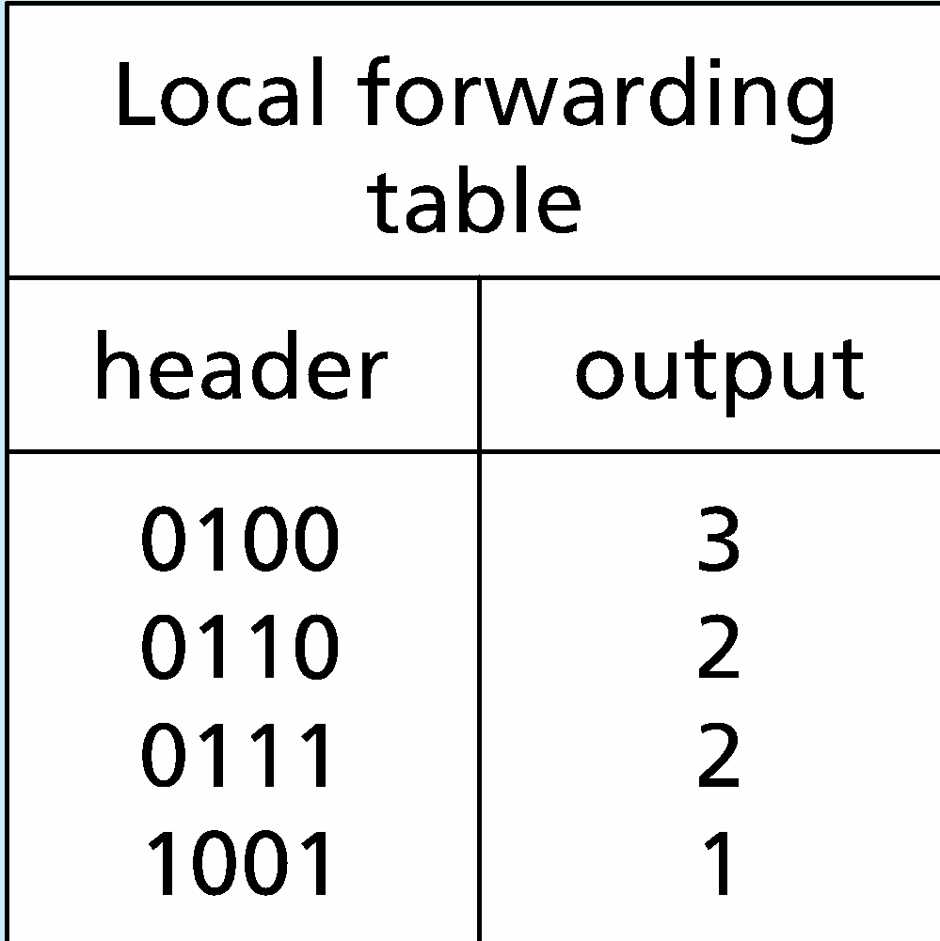
Per-router control plane
Individual routing algorithm components in each and every router interact in the control plane
Routing
Algorithm
control
plane
data
plane
values in arriving
packet header
0111
1
3
2

Slide 11
Network layer : Topics to be covered
introduction
routing protocols
link state
distance vector
intra-ISP routing: OSPF
routing among ISPs: BGP

Slide 12








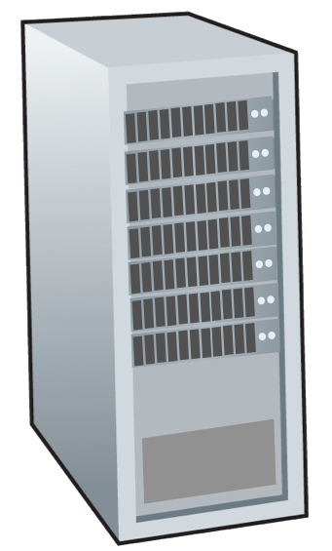






Routing protocols
mobile network
Routing protocol goal: determine “good” paths (equivalently, routes), from sending hosts to receiving host, through network of routers
path: sequence of routers packets traverse from given initial source host to final destination host
“good”: least “cost”, “fastest”, “least congested”
routing: a “top-10” networking challenge!
national or global ISP
application
transport
network
link
physical
network
link
physical
network
link
physical
network
link
physical
network
link
physical
network
link
physical
datacenter
network
application
transport
network
link
physical
enterprise
network

Slide 13
Graph abstraction: link costs
5
c_{a,b}: cost of direct link connecting a and b
e.g., c_{w,z} = 5, c_{u,z} = ∞
cost defined by network operator: could always be 1, or inversely related to bandwidth, or inversely related to congestion
v
3
w
2
5
u
2
1
z
3
1
2
x
y
1
graph: G = (N,E)
N: set of routers = { u, v, w, x, y, z }
E: set of links ={ (u,v), (u,x), (v,x), (v,w), (x,w), (x,y), (w,y), (w,z), (y,z) }

Slide 14
Routing algorithm classification
global: all routers have complete topology, link cost info
“link state” algorithms
dynamic: routes change more quickly
periodic updates or in response to link cost changes
How fast do routes change?
static: routes change slowly over time
decentralized: iterative process of computation, exchange of info with neighbors
routers initially only know link costs to attached neighbors
“distance vector” algorithms
global or decentralized information?

Slide 15
Network layer : Topics to be covered
introduction
routing protocols
link state
distance vector
intra-ISP routing: OSPF
routing among ISPs: BGP

Slide 16
Dijkstra’s link-state routing algorithm
centralized: network topology, link costs known to all nodes
accomplished via “link state broadcast”
all nodes have same info
computes least cost paths from one node (“source”) to all other nodes
gives forwarding table for that node
iterative: after k iterations, know least cost path to k destinations
notation
c_{x,y}: direct link cost from node x to y; = ∞ if not direct neighbors
D(v): current estimate of cost of least-cost-path from source to destination v
p(v): predecessor node along path from source to v
N': set of nodes whose least-cost-path definitively known

Slide 17
Dijkstra’s link-state routing algorithm
1 Initialization:
2 N' = {u} /* compute least cost path from u to all other nodes */
3 for all nodes v
4 if v adjacent to u /* u initially knows direct-path-cost only to direct neighbors */
5 then D(v) = c_{u,v} /* but may not be minimum cost! */
6 else D(v) = ∞
7
8 Loop
9
10
11
12
13
14
15 until all nodes in N'
find w not in N' such that D(w) is a minimum
add w to N'
update D(v) for all v adjacent to w and not in N' :
D(v) = min ( D(v), D(w) + c_{w,v} )
/* new least-path-cost to v is either old least-cost-path to v or known
least-cost-path to w plus direct-cost from w to v */

Slide 18
Dijkstra’s algorithm: an example
v
w
x
y
z
Step
0
1
2
3
4
5
N'
D(v),p(v)
D(w),p(w)
D(x),p(x)
D(y),p(y)
D(z),p(z)
u
2,u
5,u
1,u
∞
∞
ux
2,u
4,x
2,x
∞
uxy
2,u
3,y
4,y
uxyv
3,y
4,y
D(w),p(w)
5,u
4,x
3,y
3,y
uxyvw
4,y
uxyvwz
Initialization (step 0): For all a: if a adjacent to then D(a) = c_{u,a}
5
find a not in N' such that D(a) is a minimum
add a to N'
update D(b) for all b adjacent to a and not in N' :
D(b) = min ( D(b), D(a) + c_{a,b} )
v
3
w
2
5
u
2
1
z
3
1
2
x
y
1

Slide 19
Dijkstra’s algorithm: an example
5
v
3
w
2
5
u
2
1
z
3
1
2
D(w),p(w)
5,u
4,x
3,y
3,y
x
y
1
resulting least-cost-path tree from u:
resulting forwarding table in u:
v
w
destination
outgoing link
v
x
y
w
x
(u,v)
(u,x)
(u,x)
(u,x)
(u,x)
route from u to v directly
u
z
x
route from u to all other destinations via x
y

Slide 20
Dijkstra’s algorithm: discussion
algorithm complexity: n nodes
each of n iteration: need to check all nodes, w, not in N
n(n+1)/2 comparisons: O(n²) complexity
more efficient implementations possible: O(nlogn)
message complexity:
each router must broadcast its link state information to other n routers
efficient (and interesting!) broadcast algorithms: O(n) link crossings to disseminate a broadcast message from one source
each router’s message crosses O(n) links: overall message complexity: O(n²)

